Slide 1

Foes: Teaching JavaScript Fundamentals through a Multiplayer fighter game
Alec burns, Alex shaklee
Alex Shaklee, Alec Burns

Slide 2
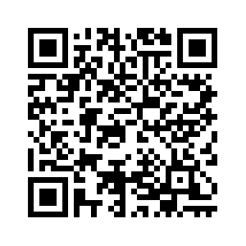
pre-survey
To access the pre-survey either copy the following link or scan the QR Code.
When asked what group this is please click ‘FOES’.
ABURNS10.ALTERVISTA.ORG OR

Slide 3

Meet the Creators of “foes”
Alec Burns
Alex Shaklee

Slide 4
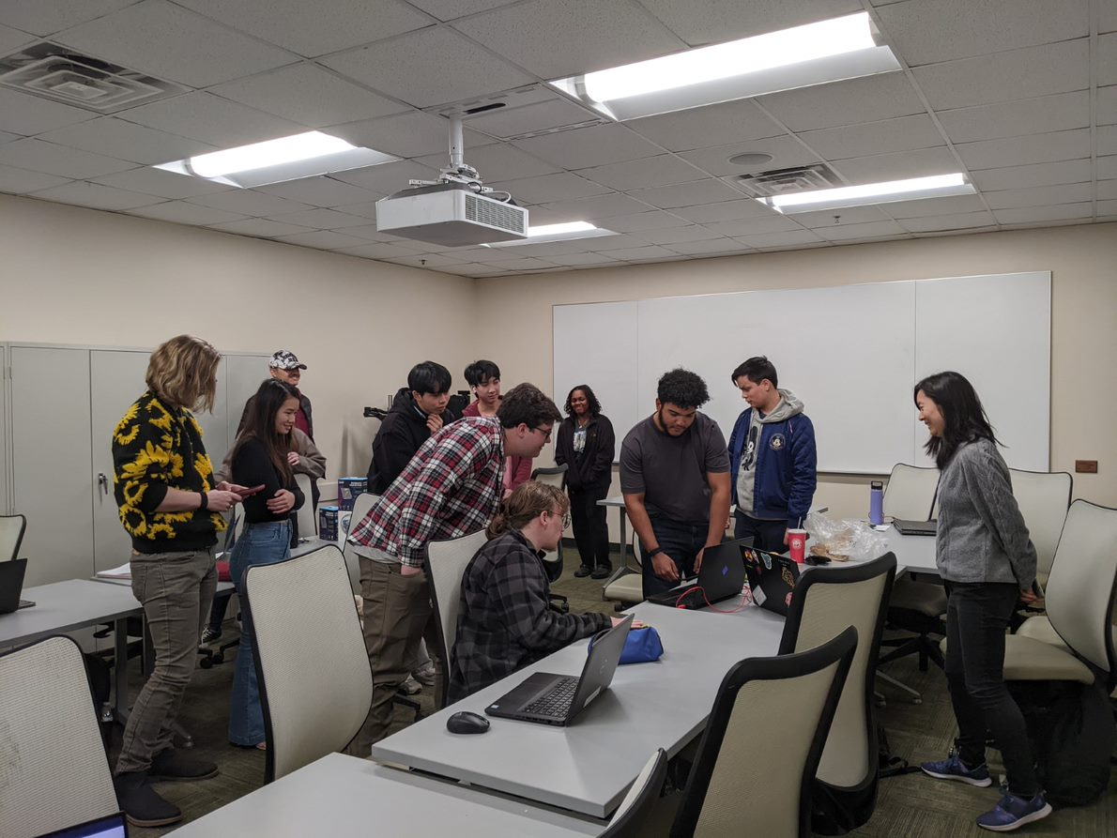
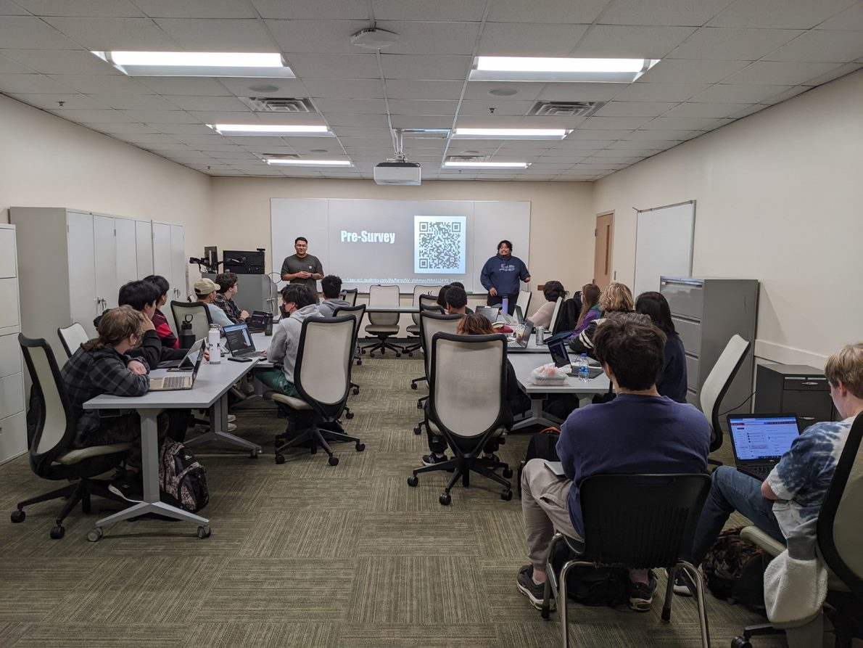
What is tap?
GGC's Technology Ambassador Program (TAP) is a program designed to give undergraduate students the opportunity to work on technical, leadership, and communication skills, all while creating projects designed for community outreach.
Team Expectations | Examples of Technology | Outreach Events
Students must participate in groups of 3-4 to gain experience with a chosen technology. Each group must then present and teach their chosen technology, both to invoke interest in their community and to achieve a deeper understanding for themselves. | Online Games (Scratch, JS) Games in Unity Hardware Controllers (Makey Makey, Arduino) AR / VR Technology and Programming 3D Printing Robotics / Drones (Sphero, Codrone) | Each team will gain the opportunity to participate in outreach-service learning events to present their projects to kids ranging from K-12 and their college peers. Example events: - Super Saturday Series - Atlanta Science Festival
STEC - 4800

Slide 5
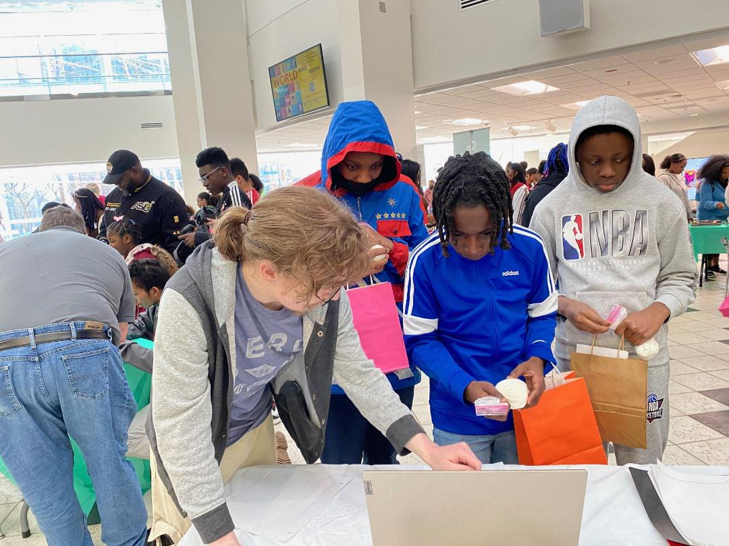
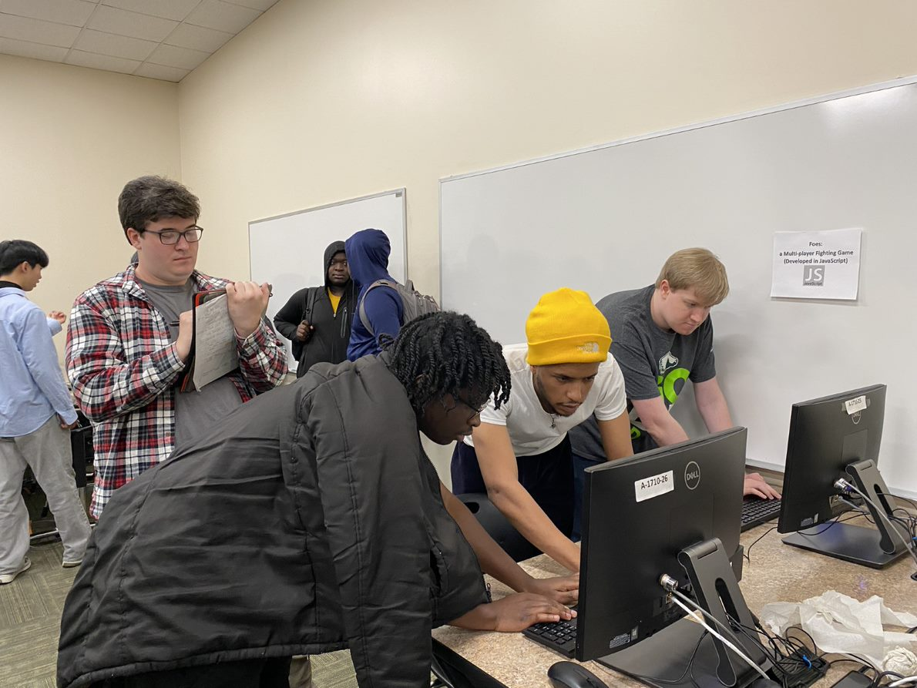
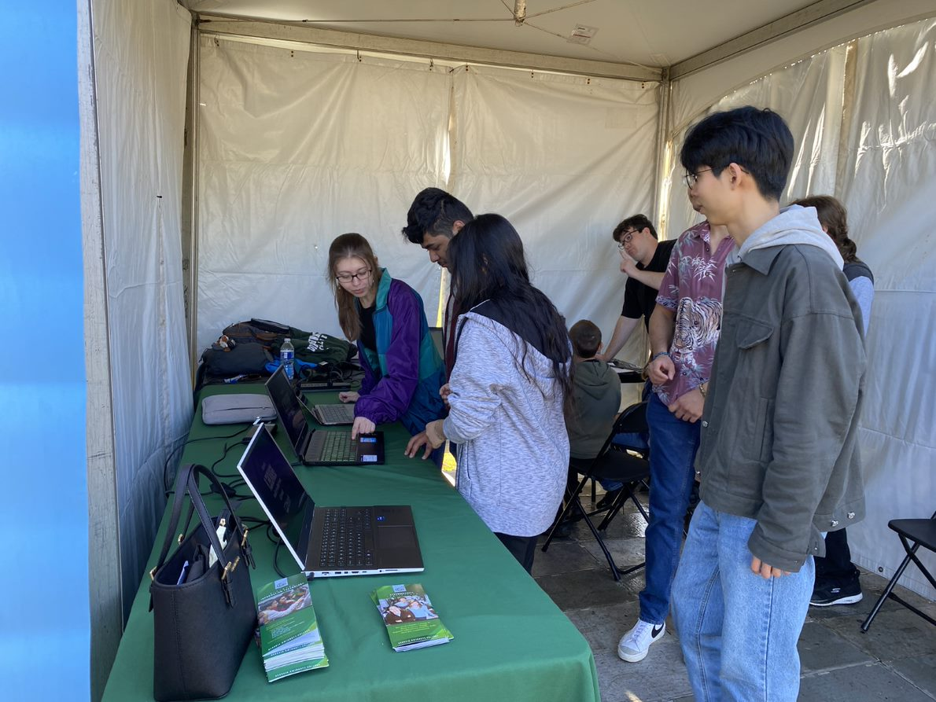
Event Examples:
Atlanta Science Festival
At GGC
GGC's TAP Expo
Atlanta Science Festival At Piedmont Park

Slide 6

What is foes? To Play
riendly, two player game
ppose your opponent
arn powerups to get stronger.
hoot the opponent to win the game
F
Simply grab a partner and use the following link:
aburns10.altervista.org
O
E
S

Slide 7
Rules FOR ‘FOES’
Each Player will start with:
3 health ‘points’
A double jump
3 'shots'
Each player must shoot the other while dodging the enemy player's projectiles. Losing your health results in a Round Loss.
However, when a player loses a round, they are offered 1 of 2 randomized powerups which can be stacked. This gives the previous loser an opportunity to win in the next round.
The first player to win 5 rounds wins the game.
PLAYER 1 CONTROLS | PLAYER 2 CONTROLS
W: Jump A: Left D: Right V: Shoot | Up Arrow Key: Jump Left Arrow Key: Left Right Arrow Key: Right Forward Slash(/): Shoot

Slide 8
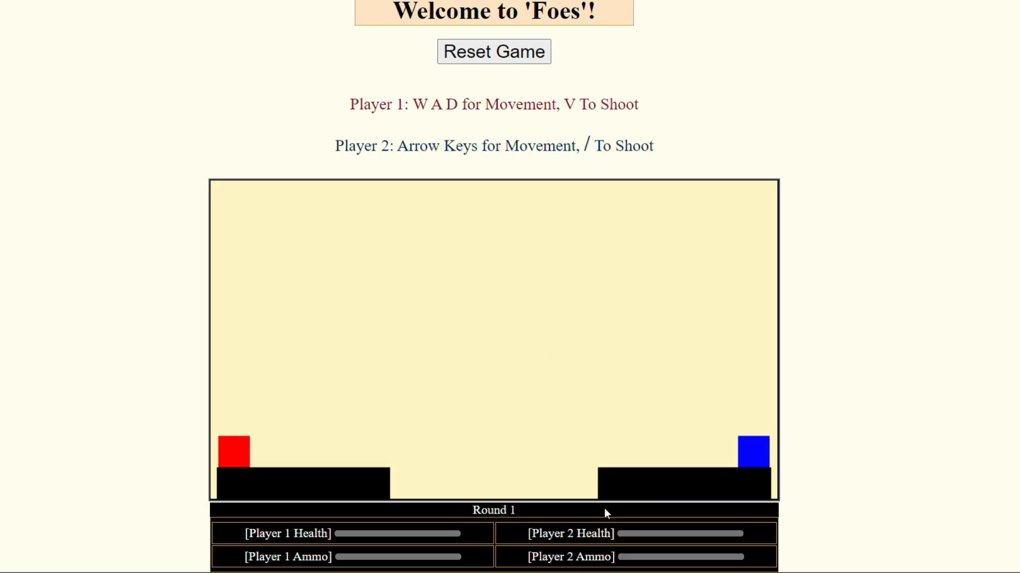
Here is an example of how FOES is played!

Slide 9
Workshop 1: Introduction Page
In this exercise, we will learn how to edit and create dynamic webpages. This exercise aims to teach students the basics of formatting with HTML and CSS, along with how the utilization of JavaScript allows us to create interactive games much like ‘FOES’.

Slide 10
Workshop 1: What is a webpage?
Web Pages are simply hypertext files hosted on the internet. Most, if not all Web Pages are formed using the following programming languages:
HyperText Markup Language Version 5 (HTML5)
Cascading Style Sheets (CSS)
JavaScript (Not Related to Java)
PHP (Hypertext Preprocessor)
The following workshop will only focus on these 3 languages

Slide 11
Workshop 1: What Can each language do?
HTML – Creates boxes on the Web Page and then stores text inside of them. These boxes are called 'Tags’
<h1> Hello! </h1> Creates a “top-level” header. This header will be large and is often used for titles.
CSS - Takes elements from HTML and changes how they look.
background-color: pink; Will change the background color of a webpage from white to orange
JavaScript/PHP - Can perform both Frontend (Client Side) and Backend (Server Side); Change web elements in ways beyond the scope of HTML and CSS. They don’t need to be used for a webpage to be functional but can be extremely useful.
*In this workshop we will not use PHP as it goes beyond the scope of this project, however it is good to know the capabilities of PHP.

Slide 12
Workshop 1: Access Workshop Materials
There are two ways to access the following workshop. This PowerPoint will highlight how to do the Workshop while using the Repo (downloaded copy on your computer).
To access Workshop 1, please make sure that you have the Foes folder on your computer. To get it please go to: TAP-GGC/Foe (github.com). Under the Documents/Installation Instructions Folders follow the PDF documents with the instructions to get FOES, Git, and Visual Studio Code.
NOTE: To see your changes in your web browser you will have to keep refreshing your webpage!

Slide 13
Step 1 – html Tags
Your code in this page is technically all html but within the html code we can specify when we will use CSS and JavaScript.
The code in between the “html tags” is our HTML code. Everything here, even if they maybe CSS or JavaScript will be run as HTML code before being converted.

Slide 14
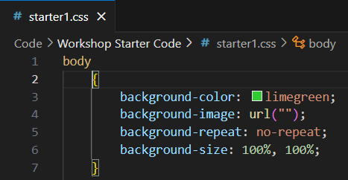
Step 1 (part 2) – style tags
This link allows our HTML page know that we have some styles we want to add to our page, and by adding this line we are linking our HTML and CSS page together.
This is the starter1.css file that we will use. This is an example of our code that will change things such as the background color of our page.

Slide 15
Step 1 (part 3) – script tags
The code in between the “style tags” is where our CSS code is. This gives us the styling of our page.

Slide 16
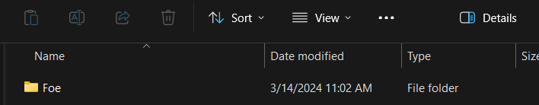
step 1 (part 4) – open foes folder
All the changes we make from now on will show up on our browser once we open our html page.
Open File Explorer and find where you downloaded your file.

Slide 17
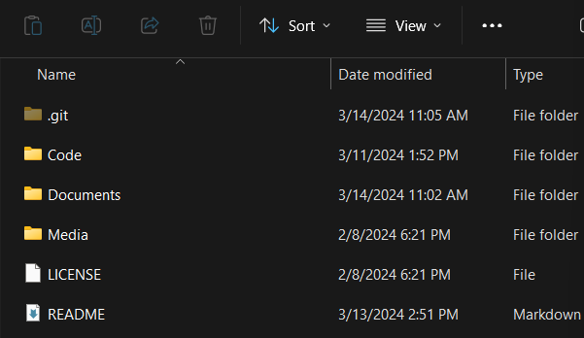
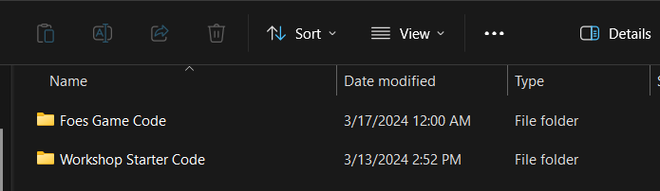
step 1 (part 5) – open folders
Click on your Folder and open your Code Folder

Slide 18
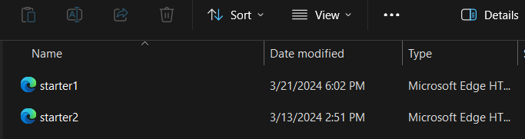
step 1 (part 6) – open Webpage Link
Open the Workshop Starter Code Folder and double – click starter1

Slide 19
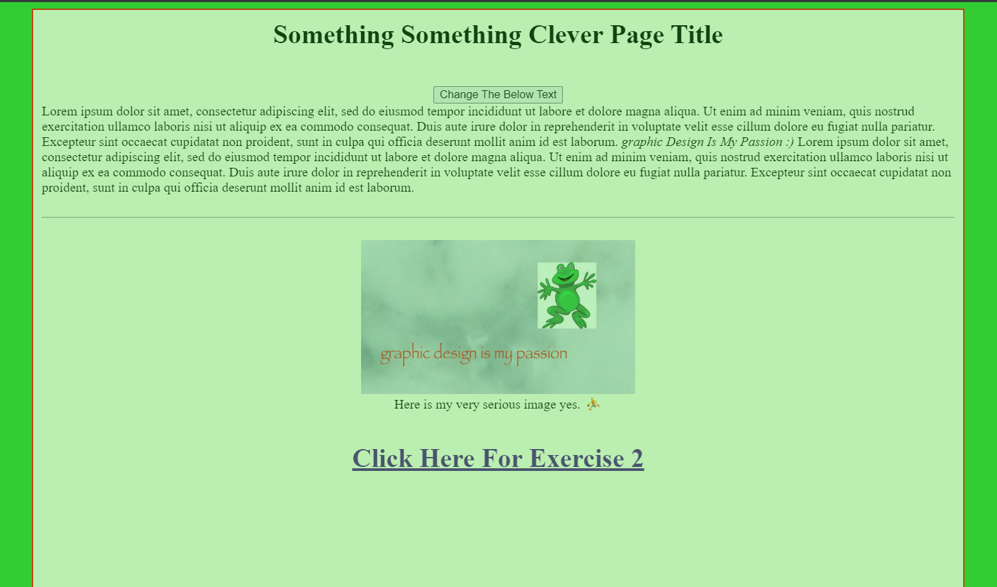
step 1 (part 7) – Webpage open
Your webpage should now be opened!

Slide 20
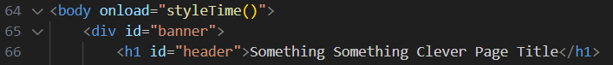
step 2 – Change Webpage title
Go back to your code and find <h1 id=“header”>”Something Something Clever Page Title”</h1>. Highlight it and replace the words “Something…” with your name.
Save your changes and then go back to your browser to see your new webpage.

Slide 21
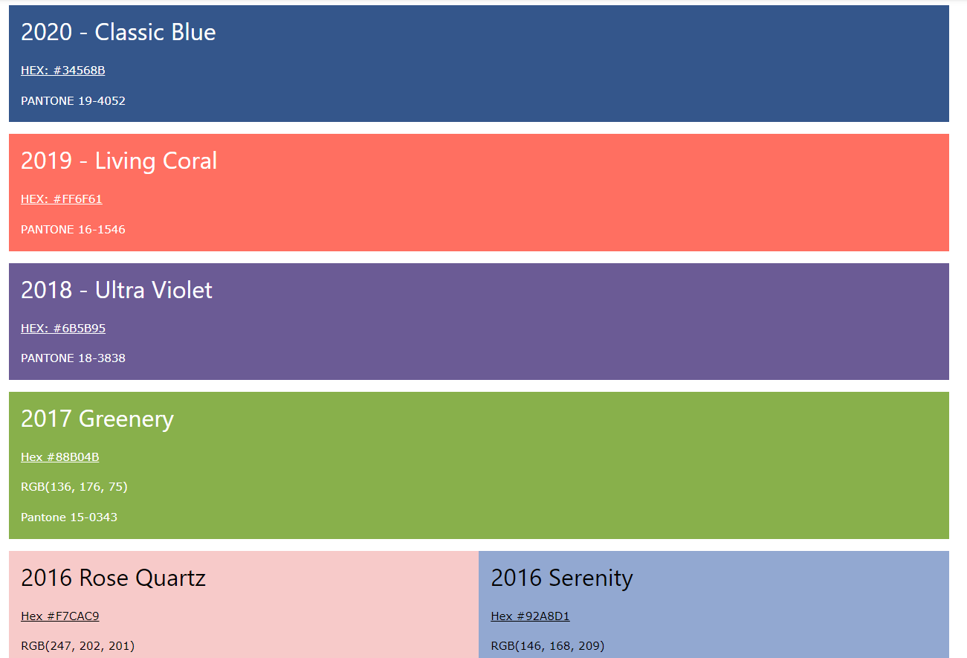
Step 3 - Change The Background Color
To change your webpage background, go to the starter1.css.
Find the body{} and look for the words “background-color: “
Replace the limegreen color with one of these or enter a color of your own!
TIP: If using your own color, be sure to stick to safe colors such as blue, green, purple….

Slide 22
step 3 (part 2) – view new webpage color
Save your changes and then go back to your browser and refresh. You should now see your webpage has changed colors.
If your webpage has a white background, it is likely that you have used a color that is not recognized. You will need to go back to your code and change the color.

Slide 23

Step 4 - buttons
A button is something that the user can click on, and when they click on it a certain action happens.
What happens when we click this button on our webpage?

Slide 24
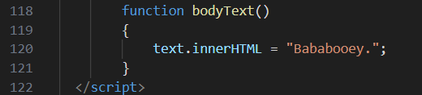
Step 4 (Part 2) – Make a function
To make our button we need to create a function in the <script></script> tags.
Let's create it under the first bodyText(){} function but let's call ours function bodyText2(){}.

Slide 25
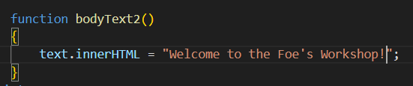
Step 4 (Part 3) – Make a Message
In your function type:
text.innerHTML = “”;
And in the quotations place your own text inside to make your own custom message. For example, “Welcome to the Foe’s Workshop!”

Slide 26
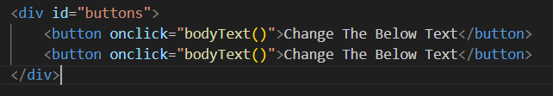
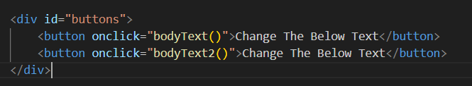
Step 4 (Part 4) – Make a button
Next go to the HTML Screen and copy the <button onclick=“bodyText()”>Change The Below Text</button>, so that way we can view our new button on our webpage. After, change the onclick method to bodytext2().

Slide 27
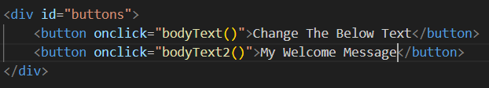
Step 4 (Part 5) – Make a button name
Change the name of your button from “Change The Below Text” to “My Welcome Message” for example.

Slide 28
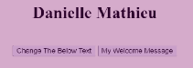
Step 4 (part 6) – click your button
Now click on your new button.

Slide 29
Step 5 – add background image
Let’s add a dynamic background image to our webpage so that way it’s not just a plain color!
To do so go to the <script></script> tags and find the three variables: rainBG, cityScape, snowyCity

Slide 30
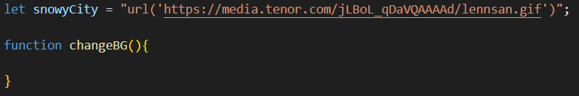
Step 5 (Part 2) – create background function
Under the last variable snowyCity let’s create a function called changeBG.

Slide 31
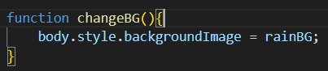
Step 5 (Part 3) – add background image
Let’s add the body.style.backgroundImage = rainBG;
You don’t have to use rainBG. You can use snowyCity or cityscape.

Slide 32
Step 5 (part 4) – add background image button
Let’s add a button under our bodyText2 function.

Slide 33
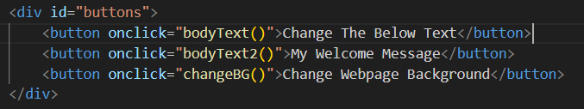
Step 5 (part 5) – add background image button
Change the onclick method to be the changeBG function we just created and change the name of the function to Change Webpage Background

Slide 34
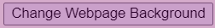
Step 5 (part 6) – Click your Button
Now click on your new button.

Slide 35


Step 6 - Change frog picture
Let’s change our frog picture to something else. In your web browser search for anything such as cats, crayons, computers and find a picture you like. Here I am searching for “Dingus the cat”.

Slide 36
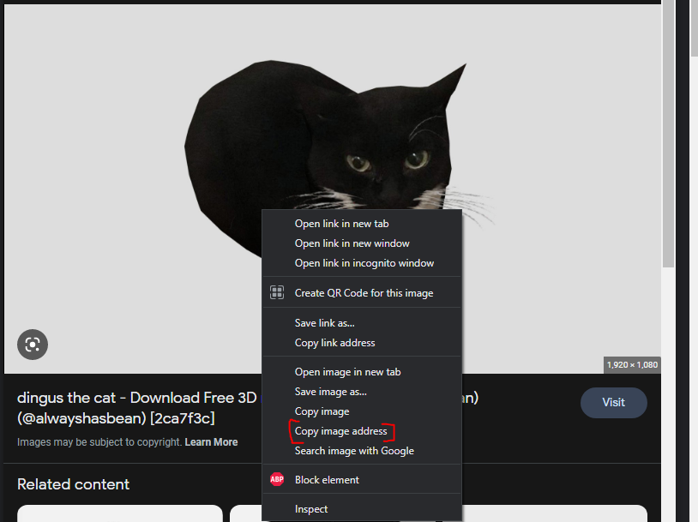
Step 6 (part 2) – Copy image address/link
Right click on the picture you chose and copy the image address/link!

Slide 37
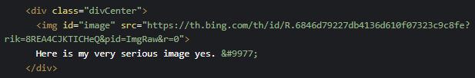
Step 6 (part 3) – Copy image address/link
Go back to your code and search for the block of code that starts with <div class=“divCenter”>. The code underneath this section is what allows us to see the image of the frog!
To make our webpage hold our picture we must replace the current src=“” link with our own.

Slide 38
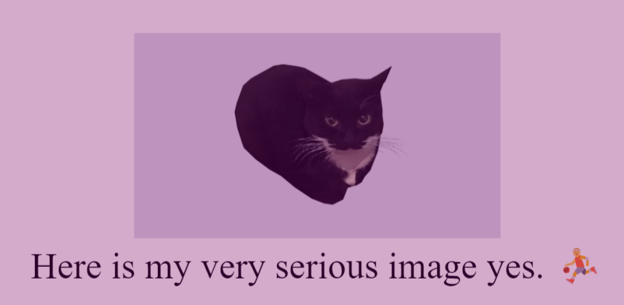
Step 6 (part 4) – Your new image
Your page should now have a new picture displayed in the middle!

Slide 39
End of workshop 1
You have now finished Workshop 1!
Try experimenting with your new webpage by adding new buttons, changing the values of the button, or changing the text/pictures!

Slide 40
Workshop 2: introduction/Access Workshop Materials
In this exercise, we will learn how to animate objects in JavaScript using the canvas
Clicking the link at the bottom of the screen will pull up the website on your browser but to also get the code you will need to go back to your code and click on starter2.html.
NOTE: It is important that as you go through this Workshop to constantly save your code and refresh your webpage that way you can get the most recent changes.

Slide 41
Step 1 – html Tags
Your code in this page is technically all html but within the html code we can specify when we will use CSS and JavaScript.
The code in between the “html tags” is our HTML code. Everything here, even if they maybe CSS or JavaScript will be run as HTML code before being converted.

Slide 42
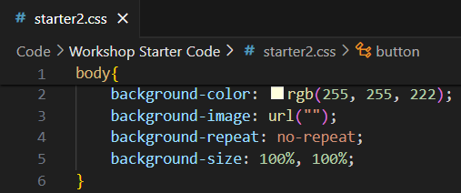
Step 1 (part 2) – style tags
This link allows our HTML page know that we have some styles we want to add to our page, and by adding this line we are linking our HTML and CSS page together.
This is the starter2.css file that we will use. This is an example of our code that will change things such as the background color of our page, but here instead of saying a specific color we are using different hues or red, green, and blue.

Slide 43
Step 1 (part 3) – script tags
The code in between the “style tags” is where our CSS code is. This gives us the styling of our page.

Slide 44
step 1 (part 4) – open foes folder
All the changes we make from now on will show up on our browser once we open our html page.
Open File Explorer and find where you downloaded your file.

Slide 45
step 1 (part 5) – open folders
Click on your Folder and open your Code Folder

Slide 46
step 1 (part 6) – open Webpage Link
Open the Workshop Starter Code Folder and double – click starter2

Slide 47
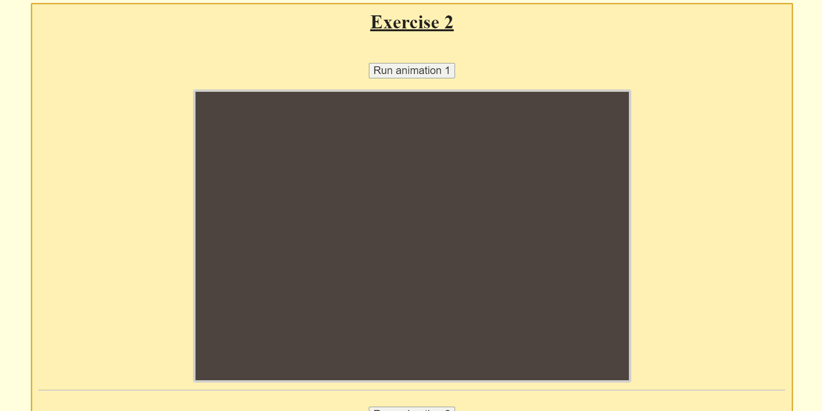
step 1 (part 7) – Webpage open
Your webpage should now be opened!

Slide 48
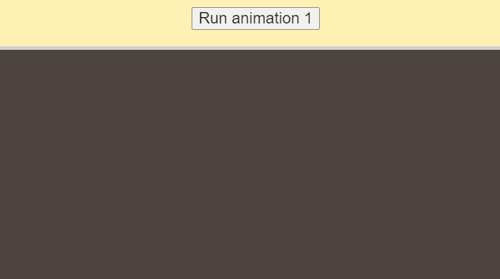
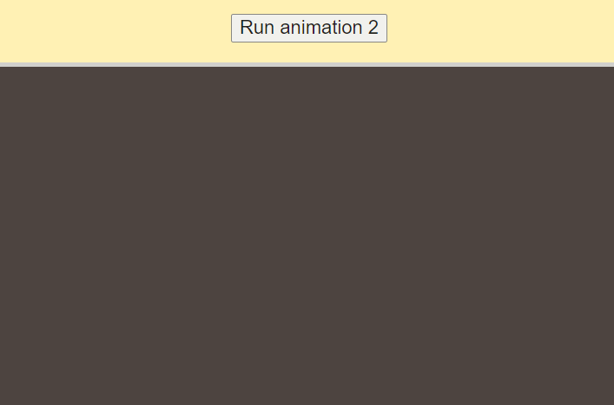
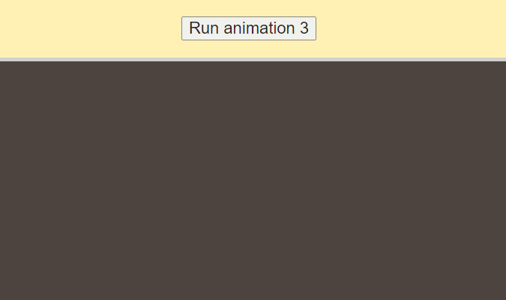
Step 2 – get familiar with your code
For this Workshop, our code will run in canvases. Canvases are the boxes that will show up under the buttons to start the animations. Each animation that we will work on will run in their own box/canvas.
Before starting click the buttons to see what each canvas does!

Slide 49
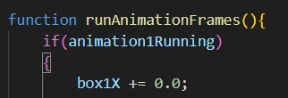
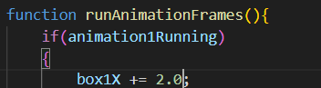
step 3 – Add animation to canvas 1
When we click on “Run animation 1”, our box does not move. To change that in our <script></script> tags find the function runAnimationFrames(){} lets change box1X += 0.0 to 2.0.
The 2.0 represent the number of pixels we want the box to move right per interval.

Slide 50
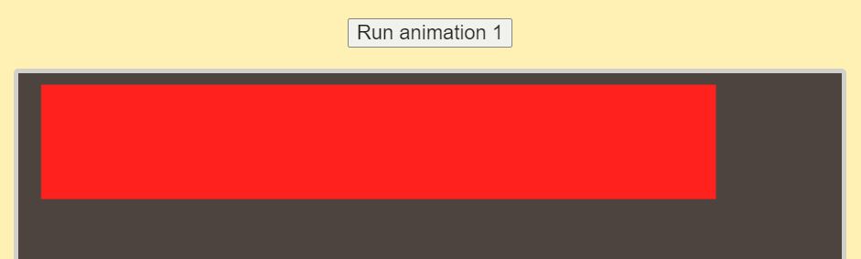
step 3 (part 2) – run animation for canvas 1
Now what happened to our animation?

Slide 51
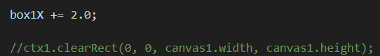
step 3 (part 3) – Fix animation for canvas 1
You will notice that the canvas still has a red box drawn on areas where our box was previously. This is because we haven't cleared out the canvas before drawing our box in a new position
We will now uncomment the line below our box1X += 2.0 to clear our canvas before a new box is drawn.

Slide 52
step 3 (part 4) – run animation Again for canvas 1
Click the button “Run animation 1” again. Now what happened to our animation?

Slide 53
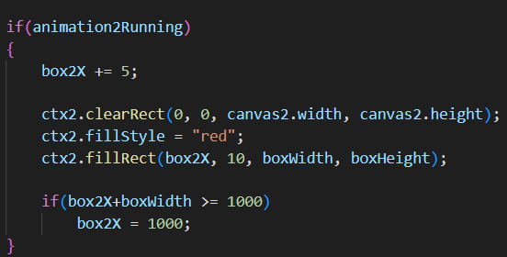
step 4 – Fix animation 2
In animation 2, when we click the “Run animation 2”, we should have the same result as animation 1.
This time, we want to prevent the box from moving off of the screen, so we are going to use if statements
We want to change 1000 to canvas2.width

Slide 54

step 4 (part 2) – What happened to animation 2?
Click the button “Run animation 2” again. Now what happened to our animation?

Slide 55
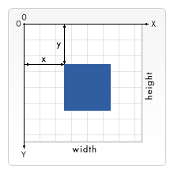
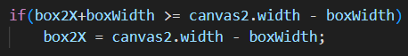
step 4 (part 3) – Subtract Box width
Despite adding the if statement, our box has still traveled outside of the canvas.
This is because when we draw the box at an X coordinate, JavaScript will draw the box to the right of the coordinate.
With this in mind, we need to set the value of X to the end of the canvas minus the box's width.

Slide 56
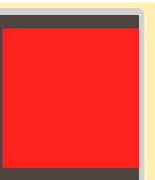
step 4 (part 4) – run animation 2 again
Click the button “Run animation 2” again. Now what happened to our animation?

Slide 57

step 5 – Run animation 3
Click the button “Run animation 3”.
Now what happens in this animation?

Slide 58
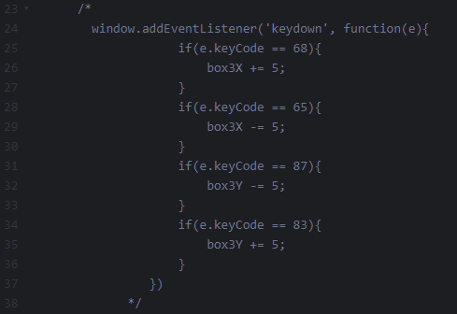


Step 5 (part 2) – run animation 3
Nothing happens because, in animation 3, we will make our box move once it receives an input from the user.
Uncomment this section of our code by getting rid of /* and */, and you should be able to now move the box using keys ‘W’, ‘A’ ‘D’, and ‘S’ (case-insensitive).

Slide 59
step 5 (part 3) – Run animation 3 again
Click the button “Run animation 3” again.
Now what happens in this animation?

Slide 60
Step 5 (part 4) – how animation 3 works
How does this code allow user input?
- First, we place an event listener to trigger whenever a key on the keyboard is pressed
- Next, we add an if statement so moving the box can only be done if the key held down is A or D
Each key on the keyboard has a number id attached to them. For example, A is 65 and D is 68. If you want to find out every number id for each key, go to this site: http://gcctech.org/csc/javascript/javascript_keycodes.htm

Slide 61
End of workshop 2
You have now finished Workshop 2!
Try experimenting with your new webpage by changing the addition or subtraction value of each key or try adding your own key codes!

Slide 62


Q/A?

Slide 63

Thank You
Credits:
Alec Burns (coding developer, web designer)
Alex Shaklee (coding developer, web designer)

